Slide 1


Team4Talent
React
Leaving the DOM behind

Slide 2
Menu
PART I: Git: What, Why, When
PART II: When=Now: Setup & Basic Demo
PART III: GitHub Collaboration
PART IV: Gitflow
PART V: Git Not So Basic
PART VI: So… You have a mess on your hands
PART VII probably won't make it…
PART VIII: Final thoughts

Slide 3
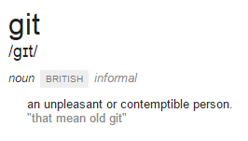
What is (a) Git
I'm an egotistical bastard, and I name all my projects after myself.
–- Torvalds

Slide 4

Git All The Things

Slide 5
Part II: When=Now: Setup & Demo

Slide 6
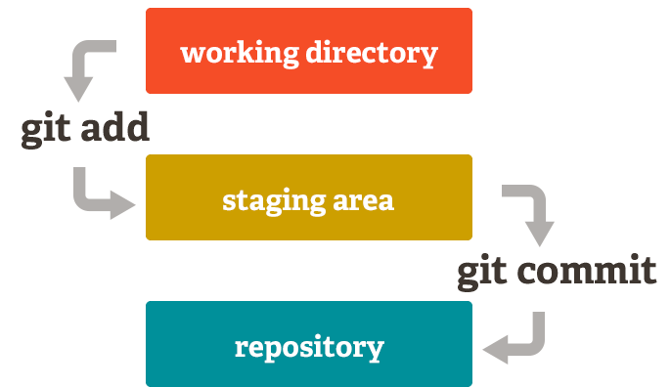
Git Basics
cd to\path
git init
git add
git commit
git push

Slide 7
Git Config
$HOME\.gitconfig
[user]
name = Barty
email = hero-bart@hotmail.com
Shell equivalent
git config --global user.name "Barty"
git config --global user.email "hero-bart@hotmail.com"

Slide 8
PART IV: Gitflow

Slide 9
PART VIII: Final Thoughts

Slide 10
What to remember
Git All Things
Especially Git folders that have brothers like _backup, _20150402 etc
Git can be strange… (It gets better with the years)
Do not rewrite published commits
Define aliases that fit your workflow
And finally:
You'll love Git (most of the time)

Slide 11
Links
Links here...

Slide 12
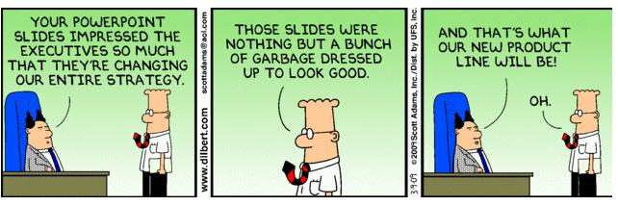
Questions?

